Slide 1
Lecture 2:
Bayesian Decision Theory
1. Diagram and formulation
2. Bayes rule for inference
3. Bayesian decision
4. Discriminant functions and space partition
5. Advanced issues

Slide 2
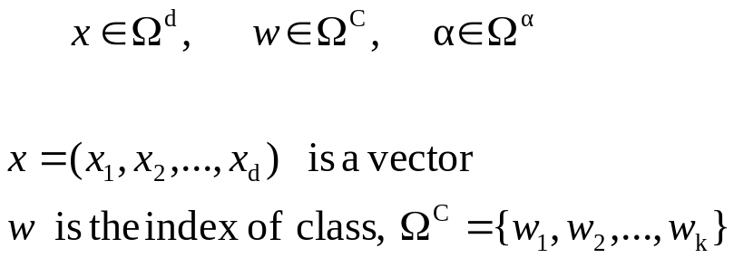
Diagram of pattern classification
Procedure of pattern recognition and decision making
subjects
Observables
X
Features
x
Inner belief
w
Action
α
X--- all the observables using existing sensors and instruments
x --- is a set of features selected from components of X, or linear/non-linear functions of X.
w --- is our inner belief/perception about the subject class.
--- is the action that we take for x.
We denote the three spaces by

Slide 3
Examples
Ex 1: Fish classification
X=I is the image of fish,
x =(brightness, length, fin#, ….)
w is our belief what the fish type is
Ω^{c}={“sea bass”, “salmon”, “trout”, …}
α is a decision for the fish type,
in this case Ω^{c}= Ω^{α}
Ω^{α} ={“sea bass”, “salmon”, “trout”, …}
Ex 2: Medical diagnosis
X= all the available medical tests, imaging scans that a doctor can order for a patient
x =(blood pressure, glucose level, cough, x-ray….)
w is an illness type
Ω^{c}={“Flu”, “cold”, “TB”, “pneumonia”, “lung cancer”…}
α is a decision for treatment,
Ω^{α} ={“Tylenol”, “Hospitalize”, …}

Slide 4
Tasks
subjects
Observables
X
Features
x
Inner belief
w
Decision
α
control
sensors
selecting
Informative
features
statistical
inference
risk/cost
minimization
In Bayesian decision theory, we are concerned with the last three steps in the big ellipse
assuming that the observables are given and features are selected.

Slide 5
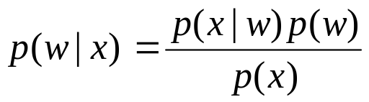
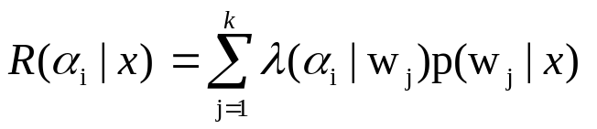
Bayesian Decision Theory
statistical
Inference
risk/cost
minimization
Features
x
Inner belief
p(w|x)
Decision
α(x)
Two probability tables:
a). Prior p(w)
b). Likelihood p(x|w)
A risk/cost function
(is a two-way table)
λ(α | w)
The belief on the class w is computed by the Bayes rule
The risk is computed by

Slide 6
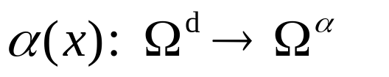

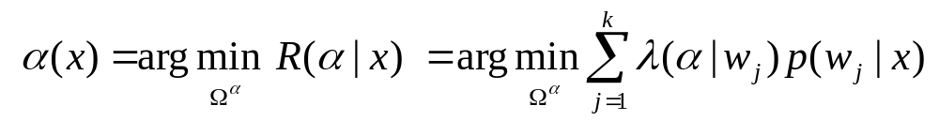
Decision Rule
A decision rule is a mapping function from feature space to the set of actions
we will show that randomized decisions won’t be optimal.
A decision is made to minimize the average cost / risk,
It is minimized when our decision is made to minimize the cost / risk for each instance x.

Slide 7
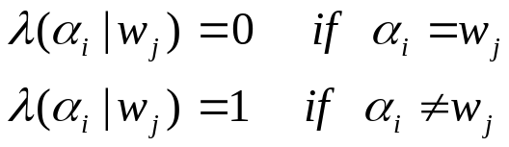
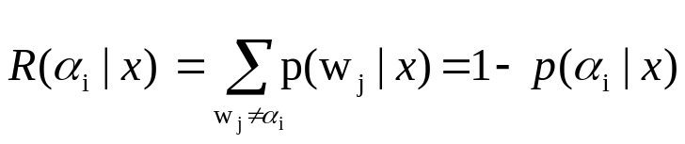
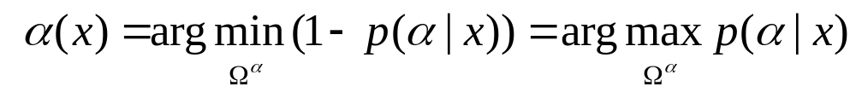
Bayesian error
In a special case, like fish classification, the action is classification, we assume a 0/1 error.
The risk for classifying x to class α_{i} is,
The optimal decision is to choose the class that has maximum posterior probability
The total risk for a decision rule, in this case, is called the Bayesian error

Slide 8
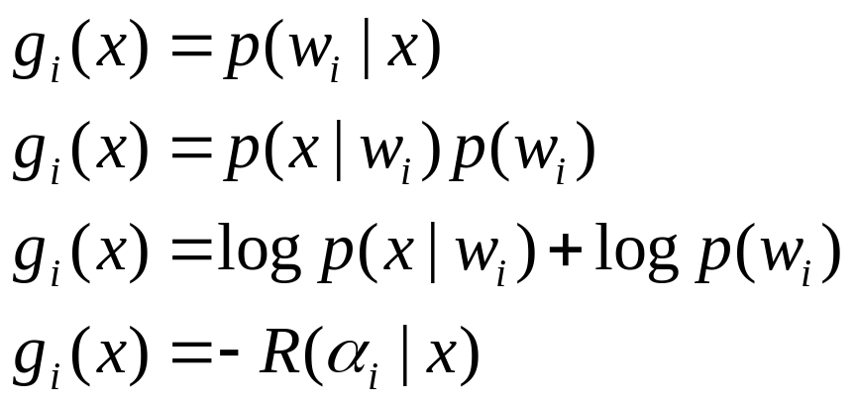
Discriminant functions
To summarize, we take an action to maximize some discriminant functions

Slide 9

Partition of feature space
The decision is a partition /coloring of the feature space into k subspaces
5
3
2
1
4

Slide 10
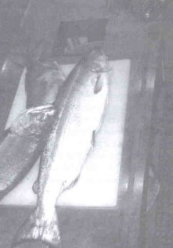
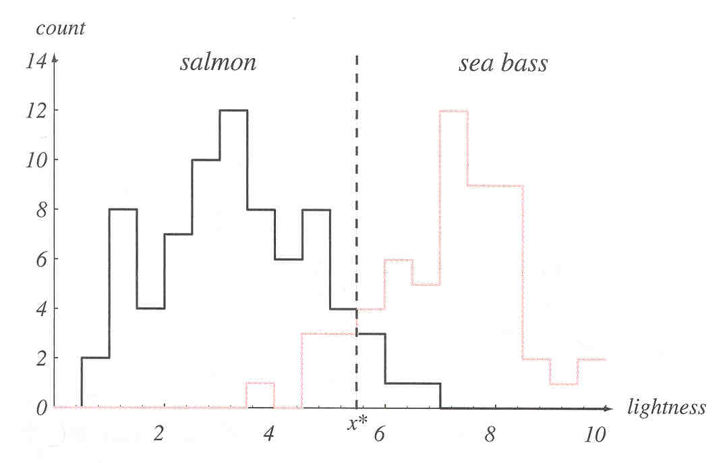
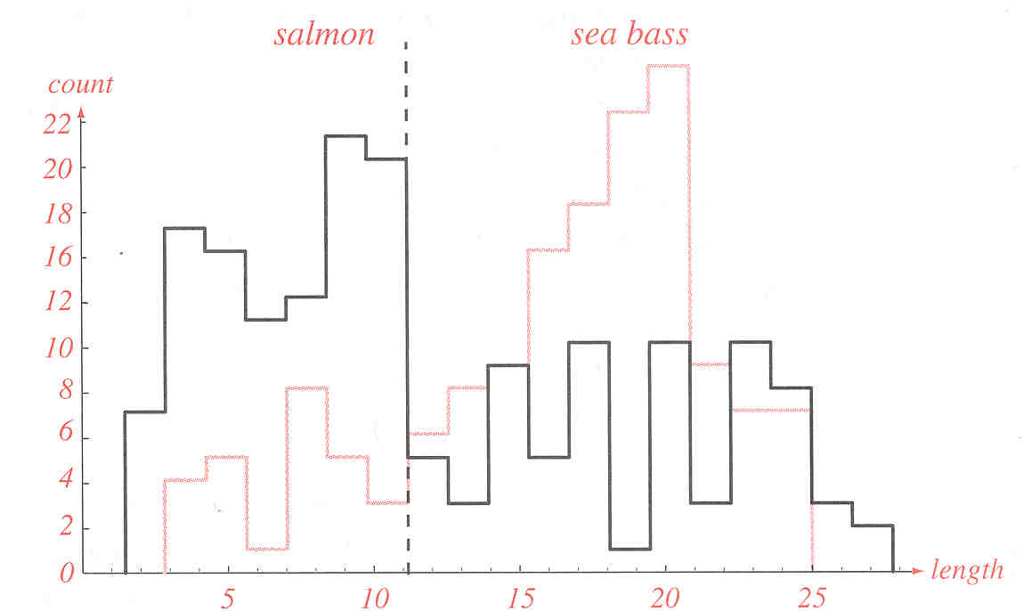
An example of fish classification

Slide 11
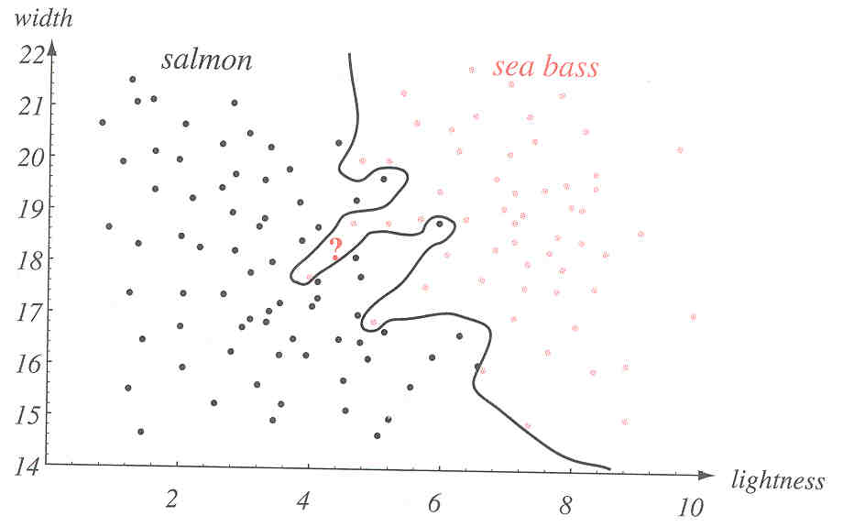
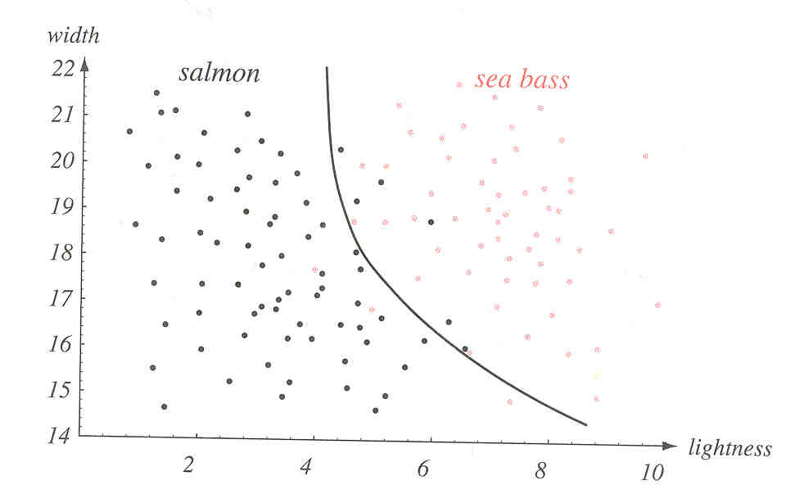
Decision/classification Boundaries

Slide 12
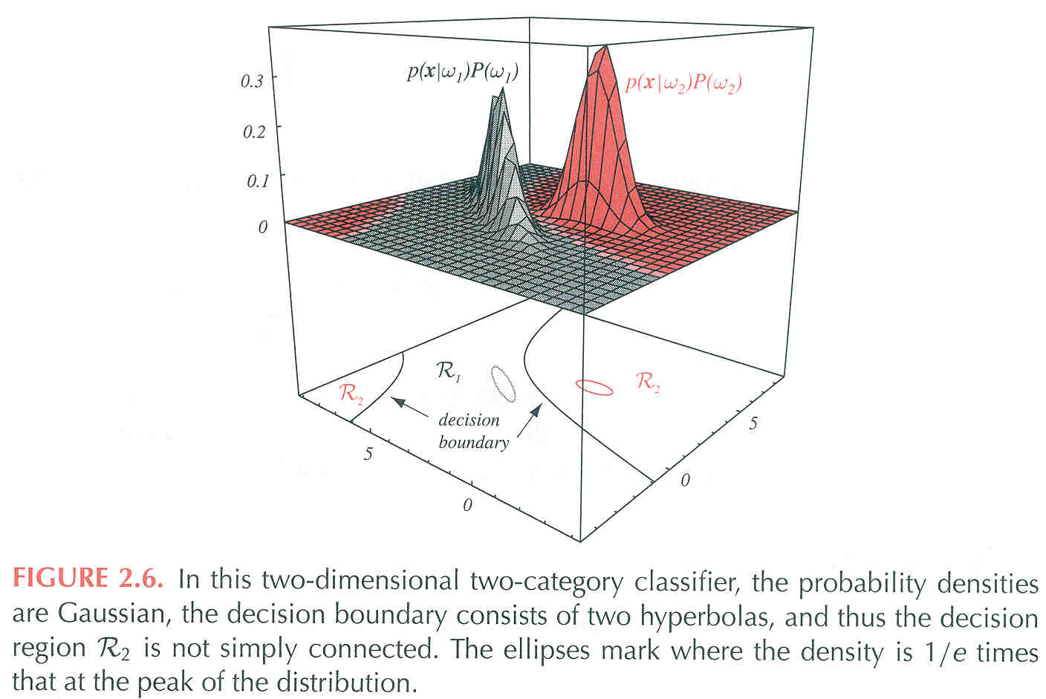
Close-form solutions
In two case classification, k=2, with p(x|w) being Normal densities, the decision
Boundaries can be computed in close-form.

Slide 13
Advanced issues
Subjectivism of the prior in Bayesian decision
Learning the probabilities p(w) and p(x|w) ---machine learning
Choosing optimal features---what features are most discriminative?
4. How many features are enough?
5. Consider the context or sequential information in classification

